Slide 1
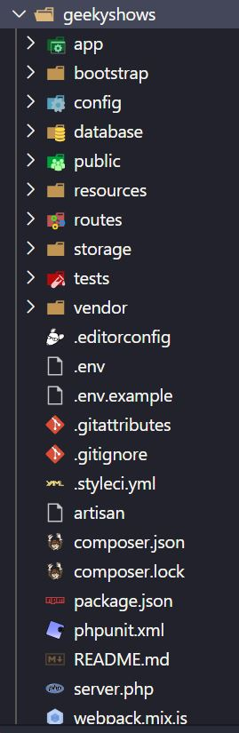
Directory Structure

Slide 2
Directory Structure
geekyshows – This is Project Folder
app – The app directory contains the core code of your application.
bootstrap – The bootstrap directory contains the app.php file which bootstraps the framework.
config – The config directory, as the name implies, contains all of your application's configuration files.
database – The database directory contains your database migrations, model factories, and seeds. If you wish, you may also use this directory to hold an SQLite database.
public – The public directory contains the index.php file, which is the entry point for all requests entering your application and configures autoloading. This directory also houses your assets such as images, JavaScript, and CSS.
resources – The resources directory contains your views as well as your raw, un-compiled assets such as CSS or JavaScript. This directory also houses all of your language files.
routes – The routes directory contains all of the route definitions for your application.
storage – The storage directory contains your compiled Blade templates, file based sessions, file caches, and other files generated by the framework.
tests – The tests directory contains your automated tests.
vendor – The vendor directory contains your Composer dependencies.

Slide 3
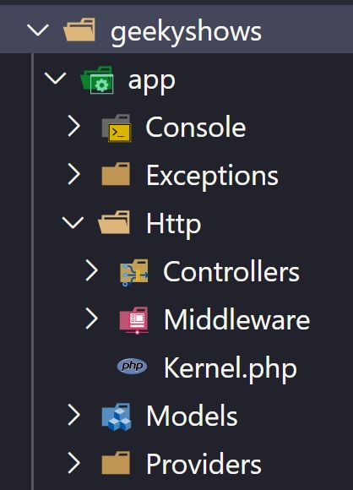
app Directory
app - The app directory contains the core code of your application.
Console – The Console directory contains all of your Artisan commands.
Exceptions – The Exceptions directory contains your application's exception handler and is also a good place to place any exceptions thrown by your application.
Http – The Http directory contains your controllers, middleware, and requests.
Controllers – It contains all controller files.
Middleware – It contains all middleware files.
Models – The Models directory contains all of your Eloquent model classes.
Providers – The Providers directory contains all of the service providers for your application.

Slide 4
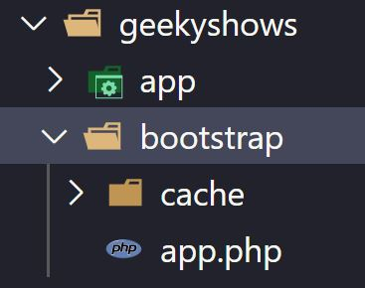
bootstrap Directory
bootstrap - The bootstrap directory contains the app.php file which bootstraps the framework.
cache – The cache directory which contains framework generated files for performance optimization such as the route and services cache files.

Slide 5
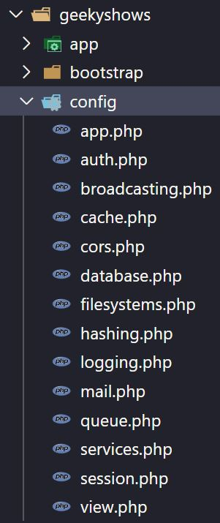
config Directory
config - The config directory, as the name implies, contains all of your application's configuration files.

Slide 6
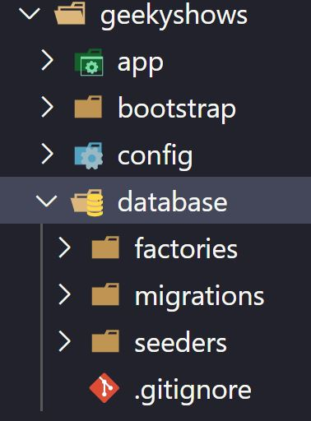
database Directory
database – The database directory contains your database migrations, model factories, and seeds. If you wish, you may also use this directory to hold an SQLite database.
factories – It contains model factories.
migrations – It contains migrations.
seeders – It contains seeds.

Slide 7
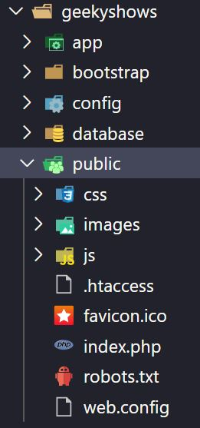
public Directory
public - The public directory contains the index.php file, which is the entry point for all requests entering your application and configures autoloading. This directory also houses your assets such as images, JavaScript, and CSS.

Slide 8
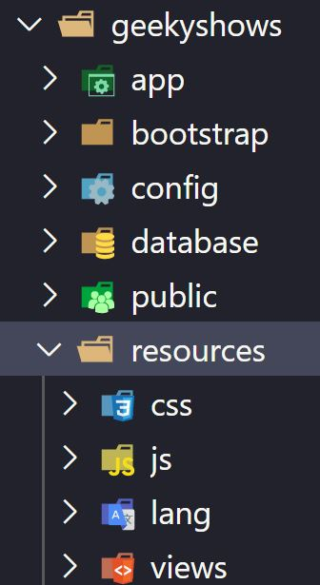
resources Directory
resources – The resources directory contains your views as well as your raw, un-compiled assets such as CSS or JavaScript.
css – It contains css.
js – It contains js.
lang – It contains language files.
views – It contains all blade php files.

Slide 9
routes Directory
api.php – The api.php file contains routes that the RouteServiceProvider places in the api middleware group, which provides rate limiting. These routes are intended to be stateless, so requests entering the application through these routes are intended to be authenticated via tokens and will not have access to session state.
channels.php – The channels.php file is where you may register all of the event broadcasting channels that your application supports.
console.php – The console.php file is where you may define all of your Closure based console commands. Each Closure is bound to a command instance allowing a simple approach to interacting with each command's IO methods. Even though this file does not define HTTP routes, it defines console based entry points (routes) into your application.
web.php – The web.php file contains routes that the RouteServiceProvider places in the web middleware group, which provides session state, CSRF protection, and cookie encryption. If your application does not offer a stateless, RESTful API, all of your routes will most likely be defined in the web.php file.

Slide 10
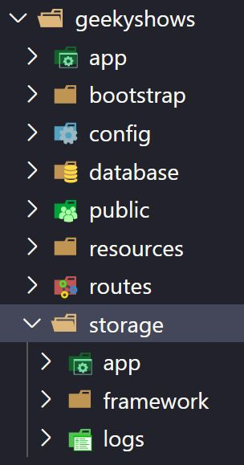
storage Directory
storage – The storage directory contains your compiled Blade templates, file based sessions, file caches, and other files generated by the framework.
app – The app directory may be used to store any files generated by your application.
public – The public directory may be used to store user-generated files, such as profile avatars, that should be publicly accessible.
framework – The framework directory is used to store framework generated files and caches.
logs – The logs directory contains your application's log files.

Slide 11
Directory Structure

